Slide 1
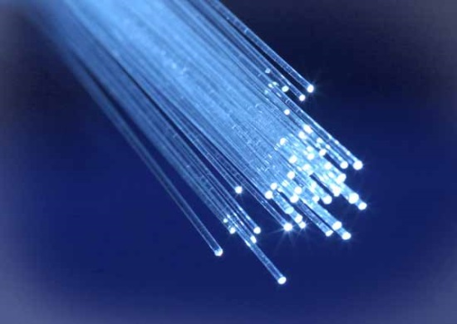
FIBER TO THE HOME - PONs

Slide 2
Why FTTH
Bandwidth - BW @ 20 Km = 2 Gbps > 80 x BW ADSL 2 +
Increased BW of HFC or xDSL technologies
WDM PON eliminates bandwidth sharing which further enhances BW
Lowest BER = 10 E-10 BPON, GPON & EPON

Slide 3
Optical Fundamentals
Types of Fiber
- Single mode (125 µm/8 -12 µm)
- Multimode ( 125 µm/ 50 or 62.5 µm)
Losses
1.Dispersion
- Chromatic – multiple lambdas
- Modal – multiple modes
2. Attenuation (dB/km)

Slide 4
Link Budget
BR
BER
Tx Power
Attenuation
Coupler, splitter, connector, splice and other losses
Amplifier Gain
Quantum Efficiency

Slide 5
Noise
Thermal Noise
Amplified Spontaneous emission
Crosstalk
Mode partition noise
Margin for environmental disturbances, aging effects, temperature changes

Slide 6
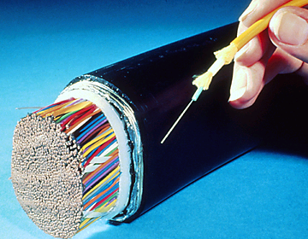
Advantages of Fiber
Extremely light weight
EMC
-No Emanation
-Not susceptible
A single copper wire can carry 6 phone calls compared to single fiber which can carry 2.5 million simultaneous phone calls (64 channels at 2.5 Gb/s)
Less than 1% the size and weight of copper

Slide 7
Architecture
Point to Point or star topology
Ring Topology
Point to Multipoint (P2MP) = PON

Slide 8
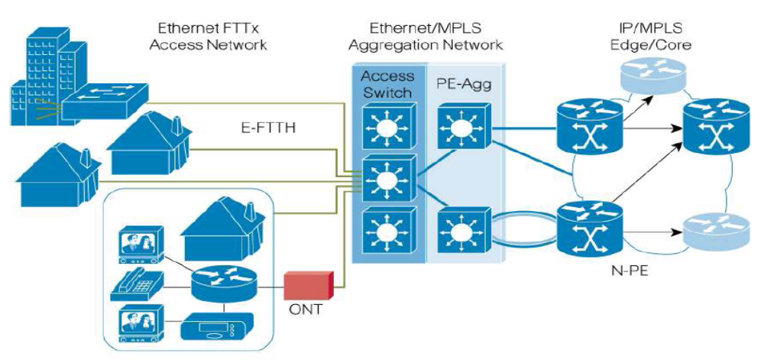
E-FTTH Architecture – P2P
(can be implemented in a ring)

Slide 9
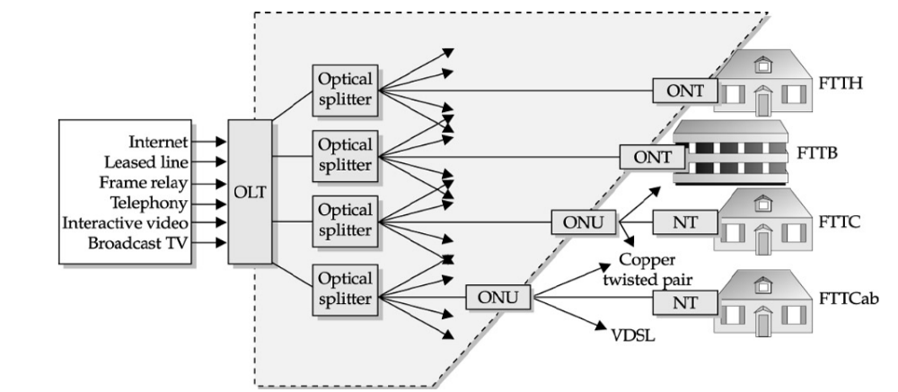
PON FTTx Architecture

Slide 10
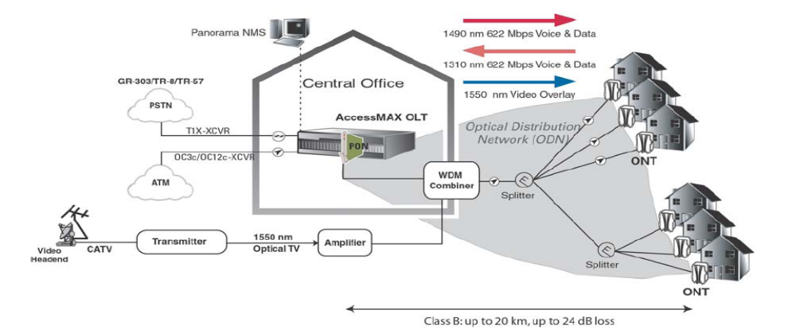
PON as FTTH

Slide 11
Equipment
Optical Network Unit (ONU)
Optical Line Terminal (OLT)
Optical Distribution Network (ODN)
Optical Amplifiers
Splitters and Connectors
Lasers Transmitters and Receivers

Slide 12
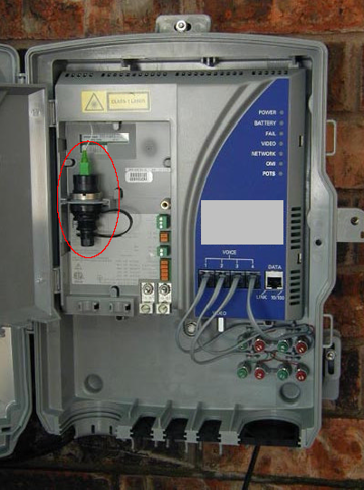
ONU
Optical Network Terminal is
located near end users.
Consists of
- 1, Coax cable
- 4, RJ-11
- 1, RJ-45
- 1310nm Laser
- Triplexer Module
Downstream voice, data – 1490 nm
Upstream voice, data – 1310 nm
Video – 1550nm
UPS

Slide 13
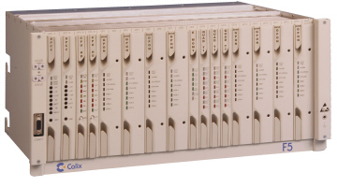
OLT
Present at the head end or the central office end
Consists of plug-in-card
each of which can support
upto 64 ONU’s
Uses BPON, GPON or
EPON protocols
Supports Management and supervisory functions – GUIs
Back Haul is handled by DS3, OC3 or Gigabit Ethernet card.

Slide 14
ODN
Passive Network
No active Components between OLT
& ONT.
Eliminates the need for DC power
Low network maintenance cost
It involves splitter

Slide 15
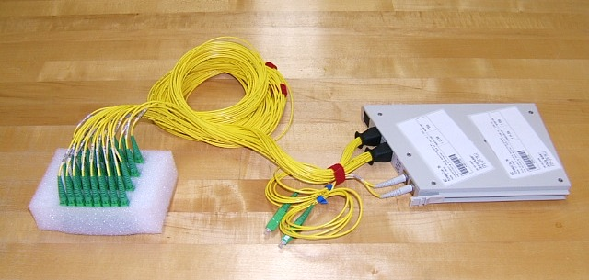
Splitter
Passive Component
Distributes optical signals to multiple Subscribers
Also acts as a Coupler

Slide 16
Splitter Losses
Each split = 3dB loss of signal
16 splits = 12 dB of signal loss
  2E4 = 16
  4splits x 3dB/split = 12dB loss

Slide 17
Video Overlay Equipment
Optical Transmitter
Video stream @1550 nm over Optical Fiber
WDM Combiner (Optical Coupler)
Couples Downstream video to upstream/downstream data and voice
Optical Amplifier
Amplifies 1550nm broadcast signal.

Slide 18
Lasers
Fabry-Perot lasers
-lower in cost and power
- poor wavelength stability
Distributed Feedback (DFB) Lasers
- Higher cost and power
- Excellent wavelength stability
- Excellent temperature stability
- internally modulated – good for moderate power and distance
- Externally modulated – Broadcast applications
Vertical Cavity Surface Emitting Lasers (VCSELs)

Slide 19
Wavelength Vs Lasers
1310 nm
- Usually lowest cost lasers Used for shorter broadcast runs and short to moderate data runs
1550 nm
- Can be amplified with relatively low-cost erbium doped fiber amplifiers (EDFAs)
- Lasers are fabricated on a number of different wavelengths (about 1535 – 1600 nm) for wave division multiplexing (WDM) applications
Slightly lower fiber loss at 1550 nm
1490 nm
- Increasingly popular for downstream data. Cannot be amplified as easily. Somewhat higher device cost

Slide 20
Standards
TDMA PON – First proposed in 1987 by researchers at BT laboratories
ITU: FSAN (1996)
BPON – G.983
GPON – G.984
EPON – IEEE 802.3ah

Slide 21
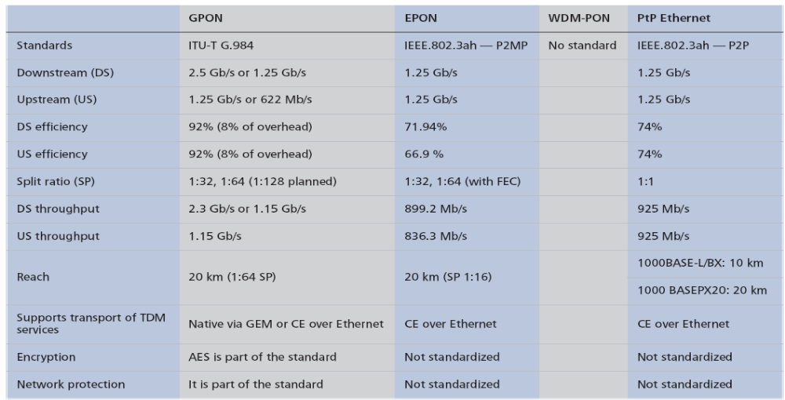
Standards

Slide 22
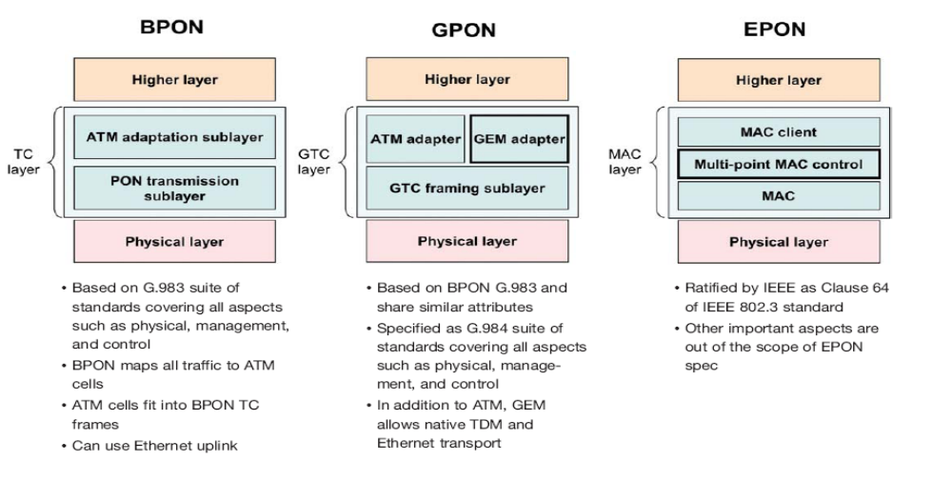
PON standards

Slide 23
BPON G.983 – 155/622 Mbps
Physical Medium Dependent Layer
BPON Transmission Sub layer of TCL
BPON Adaptation Sub layer of TCL
- Conversion between ATM and PDUs
Security
- Churning: Downstream in Pseudorandom way & permutation key changed once per sec

Slide 24
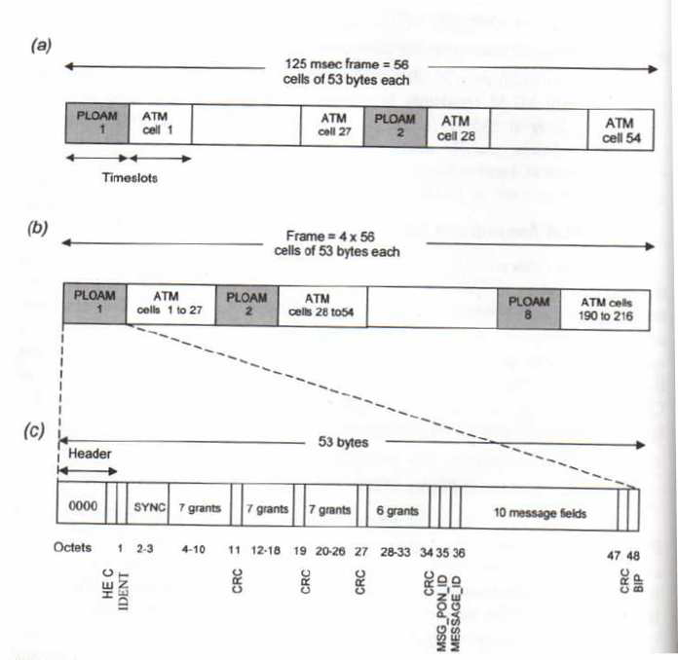
BPON Downstream Format

Slide 25
Downstream Fields – OLT to ONT
Physical Level Operations and Maintenance – PLOAM
ATM Cells
Message Fields

Slide 26
PLOAM Function
IDENT,MSG and BIP fields are common to both Up and Downstream PLOAMs
  IDENT – frame delineation
  MSG – CPE to Network communication
  BIP – parity check (layer 2)

Slide 27
Downstream PLOAM Fields
Grants – in first 2 PLOAMS
  Each of these 2 carry grants for 27 Time Slots
    Total 54 Time Slots per Frame
      Act as Media Access Control
Message Fields determine grant usage and ranging parameters
ATM – carry traffic

Slide 28
Ranging Grants
ONU’s are located at different distances from the OLT
PLOAM cell address the station to be ranged and open up a window wide enough to receive the upstream PLOAM cell.
OLT range determines an equalization delay, providing the ONU a window within which it is allowed to start sending.

Slide 29
Upstream Only Fields – ONT to OLT
Laser Control Field
  ONU reports power level and extinction ratio of its own Laser to maintain proper TX level.
Receiver Control Field
  OLT detects its own threshold level for distinguishing of “zero” from “one”

Slide 30
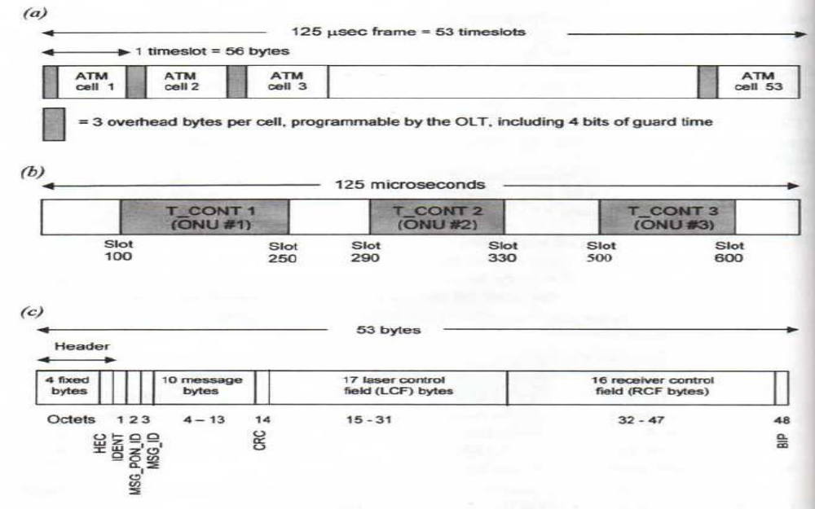
BPON Upstream Frame

Slide 31
GPON G.984
Uses GEM ( GPON Encapsulation): Enable to host different packetsize traffic formats such as Ethernet
Uses Advanced Encryption Standard (Symmetrical crypto system)
X-ORing of the payload with AES key for encryption and same X-OR at receiver for decryption

Slide 32
GPON Features
Scalable framing structure
  622Mb/s to 2.5Gb/s, as well as asymmetric bit rates support.
Exceptionally high bandwidth utilization/efficiency for any type of service
A variant of Generic Framing Procedure (GFP) encapsulation of any type of service (both TDM and packet) into 125 μsec periodic frames.

Slide 33
GPON Features
High efficiency with no overhead transport of native TDM traffic.
Dynamic Allocation of upstream bandwidth via bandwidth maps (pointers) for each ONT – Asymmetric Services
Uses a variation of GFP

Slide 34
GPON Encapsulation - GEM
ITU-T recommendation G.7041 = GFP
SONET/SDH and ITU-T G.709 (ONT)
Supports
  IP/PPP (IP/Point-to-point Protocol
  Ethernet MAC)
  Constant Bit Rate streams
    Ex – TDM - as it uses 125us framing

Slide 35
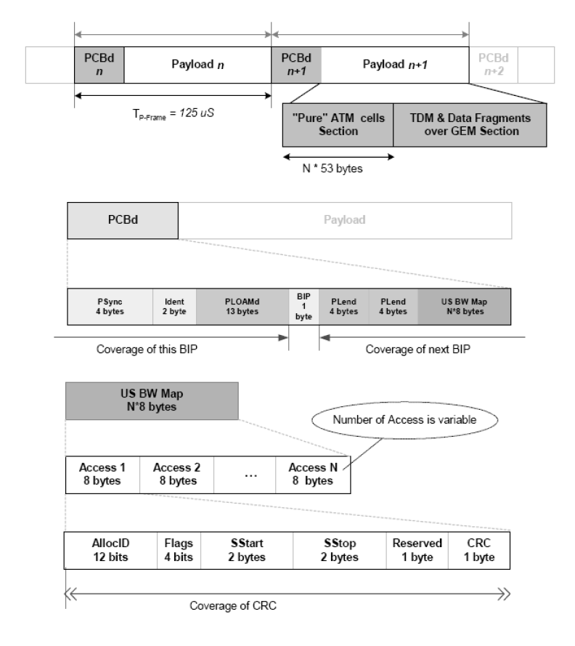
GPON Downstream Format

Slide 36
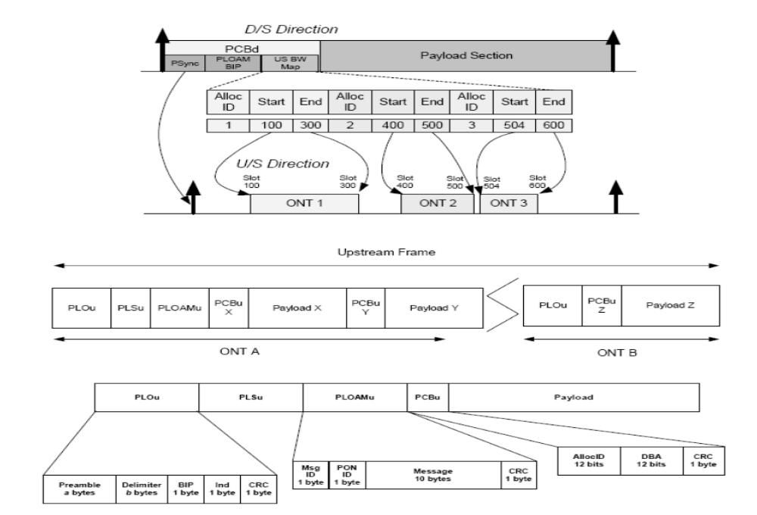
GPON Upstream Format

Slide 37
Ethernet Based PON - EPON
P2MP
Splitters
MPCP as the MAC layer
  Uses a LLID – Logical Link ID

Slide 38
MPCP - Function
OLT sends discovery gate message request to all unregistered ONUs
ONUs acknowledge by using Registration Request (REGISTER REQ) message
When received and approved the OLT registers the ONU using the REGISTER message
The handshake ends with the ONU acknowledgement REGISTER_ACK

Slide 39
Ethernet Based PON - EPON
Does not support TDM services
Uses 8B/10B line encoding
  20% BW Penalty – due to added bits
    DC leveling
    Note - BPON/GPON – use scrambling

Slide 40
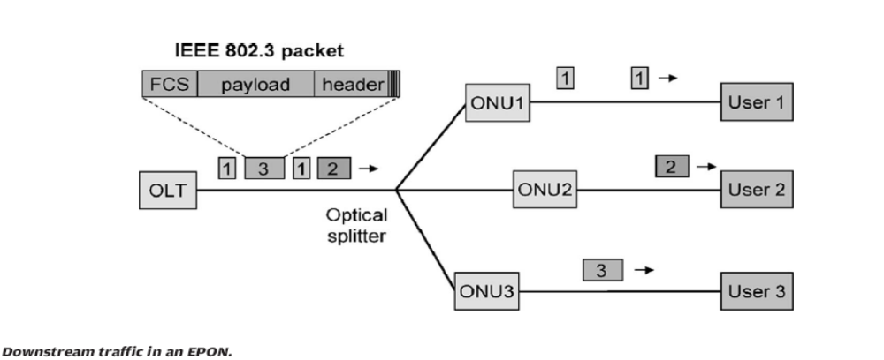
EPON Downstream

Slide 41
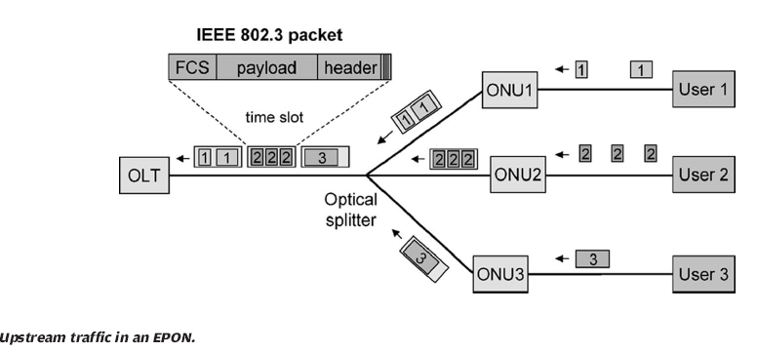
EPON Upstream

Slide 42
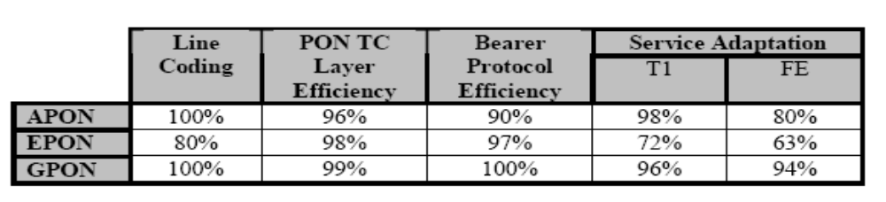
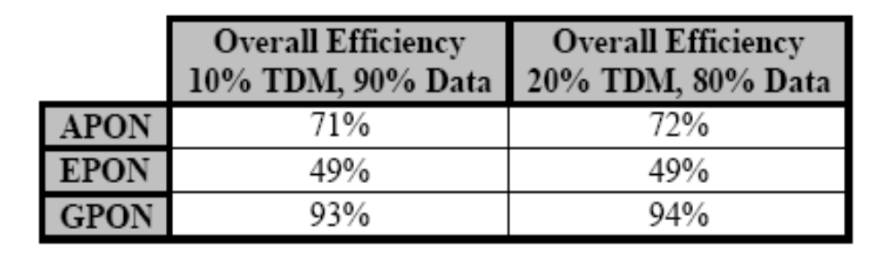
Efficiency Comparison

Slide 43
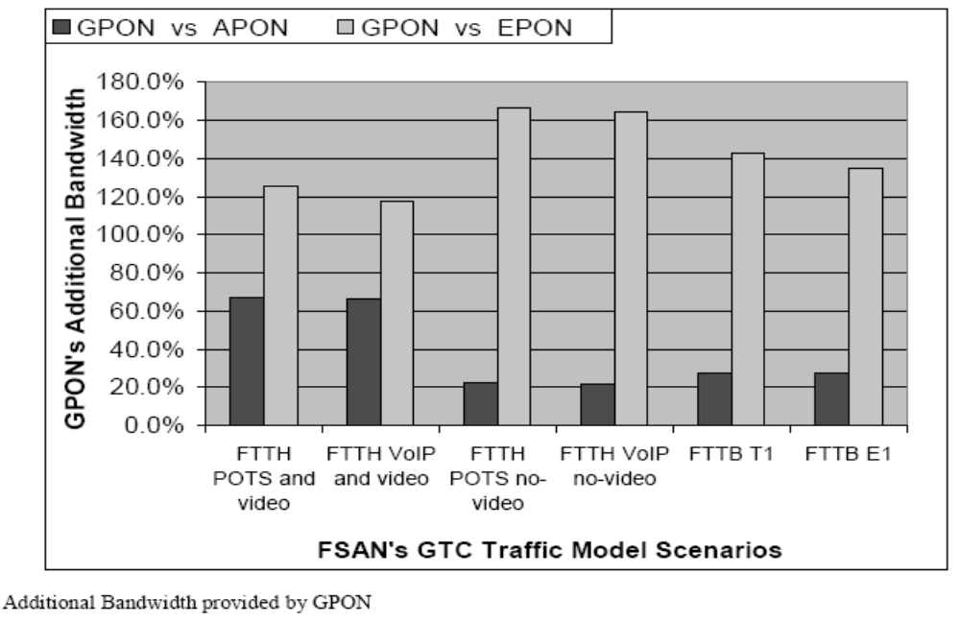
PON system Performance

Slide 44
WDM - PON
1 lambda per ONT
1 Gigabit per second
Point to Point access –P2P
Lower Laser Power Required

Slide 45
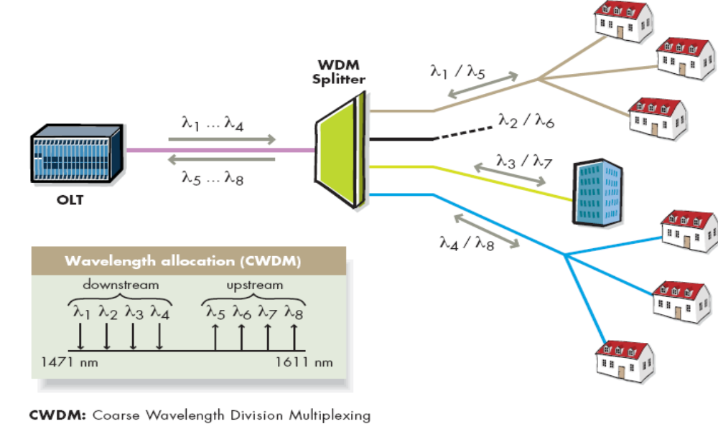
WDM PON

